Slide 1
Building Your Toolbox of ELL Strategies
Facilitators:
Erica Hilliker
Casey Gordon

Slide 2
Objectives
Content Objective:
The participants will identify classroom strategies that are effective for the instruction of ELLs.
Language Objective:
The participants will discuss and orally evaluate classroom strategies for ELLs.

Slide 3
Building Background- RallyTable
What is a classroom strategy you have found useful for ELLs?
Directions:
Divide the class into small table groups.
Pass out a blank piece of paper and a pencil to each table.
Participants will take turns passing the paper and pencil, each writing one answer or making one contribution until time is up.
Participants will discuss the ideas on the paper and select one idea to present to the rest of the class.

Slide 4
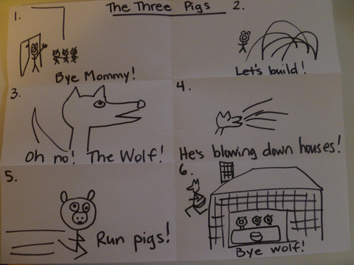
Toon It
Students retell a story by choosing the 6 most important events and drawing them in order as a cartoon on a sheet divided into 6 squares with captions.
For example, for The Three Pigs:
1) The pigs leave home
2) The pigs build.
3) The wolf comes.
4) He blows down houses.
5) The pigs run!
6) The wolf runs away.
Students create quick sketches to illustrate the 6 major events of the story and write short phrases or sentences as captions for each frame.
Variations & Extensions - Students can copy the whole class version written on the document camera or overhead. Pairs or small groups of 6 can create their own cartoons of short stories they know, each student illustrating one of the 6 frames.

Slide 5
The First Thanksgiving
Divide paper into 4 squares
Choose the 4 most important events
Draw them in order as a cartoon
Write short phrases / captions for each frame

Slide 6
Reflection
Why would Toon It be a useful strategy for ELLs?
How would you modify this activity to fit your content-area or grade level?

Slide 7
Toon It With Technology
Make Beliefs Comix

Slide 8
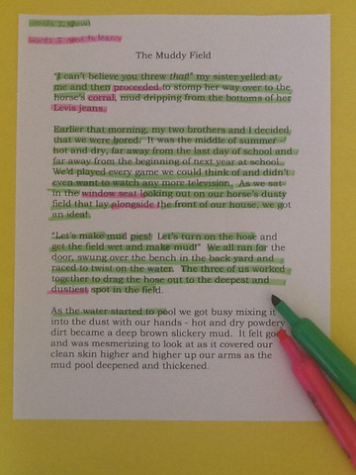
Two Color Highlighting
When students read a text, give them two different color highlighters: words they know in one color and words they need to learn in the other color.
As students read, they highlight the appropriate words. The teacher can assess the level of difficulty for students by checking to see what they have highlighted.
Variations & Extensions - Direct students to copy down the words they do not know on a list. These then become words that they need to define in their personal dictionary or words that the teacher needs to incorporate into their word study and vocabulary explanations. Choose an additional color for key vocabulary that is the focus of current study.

Slide 9
“Cosmos is Inherently Unstable”
Read article
Highlight the words you don’t know in orange
Highlight familiar words in yellow

Slide 10
Reflection
Why would Two Color Highlighting be a useful strategy for ELLs?
How would you modify this strategy to fit your content area or grade level?

Slide 11
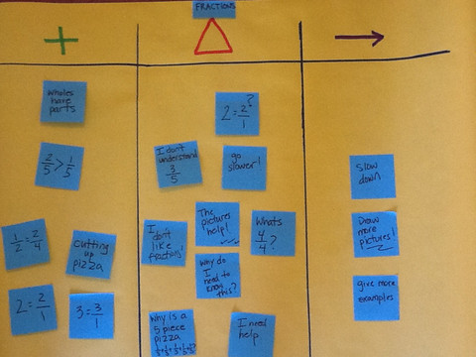
Plus/Delta Assessment
This is assessment is a quick way to assess student understanding of a lesson, unit, or concept. Under the + symbol volunteers explain what they understand, know, or enjoyed about learning the topic.
Under the △ (“delta”) symbol, the teacher records things that students think need to change, be improved, or still do not understand.
Under the → (arrow) students write what we should do next based on what they have said they know and do not know.
They can use individual sticky notes or share orally for a teacher or volunteer to record their responses.
Variations & Alternatives: Try sentence starters like: “I liked...” “I know..” “I didn’t like...” “I didn’t understand...” “I wonder..” etc.

Slide 12
Plus / Delta - SIOP Model
+ = what you know about the SIOP model
△ = things you still don’t understand or need to know more about
→ = what you should do next, based on what you need to know

Slide 13
Reflection
Why would Plus/Delta Assessment be a useful strategy for ELLs?
How would you modify this strategy this fit your content area or grade level?

Slide 14
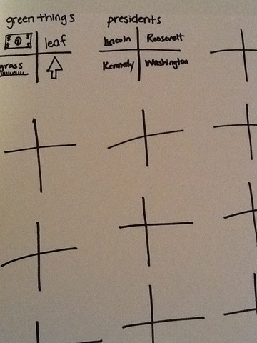
Four Examples For
First, make a list of 5-10 topics that your have been studying.
Next, individually or in pairs come up with 4 examples for each topic and record them on a sheet with that same number of large +’s. For example: 4 examples of freedom; 4 routes of blood; 4 greetings etc.
Variations and Extensions: For a quicker review, call on students randomly or volunteers share examples of the topic or concept and the teacher or everyone records the information. Once students have finished their lists, have them rank-order them with the best examples first. Use photographs or sketches that can be glued into the correct space for each topic for younger children or children with lower proficiency levels.

Slide 15
Four Examples for - Content
ELA – 4 parts of speech
Math – 4 types of operations
Science – 4 types of habitats
Social Studies – 4 types of landforms
Early Elementary – 4 vowels

Slide 16
Reflection
Why would Four Examples For be a useful strategy for ELLs?
How would you modify it to fit your content area or grade level?

Slide 17
Loops Review
First, tape 5-6 large circles on the floor or use hula hoops. Label each circle with a category card (e.g. greetings, dictators, nouns, green things etc.) that relate to what you are studying.
Next, students mingle to music and when the music stops, they step in or place a foot into the nearest circle and name an example of that category. For example, for the category "green things" they could say "tree" or "grass".
Variations & Extensions Students can be numbered and the teacher can all out "1's answer". Students can carry whiteboards and record the words. They can make sentences or must use their last word and the new word in a sentence. Be creative while reviewing key concepts and vocabulary.

Slide 18
Loops Review - Content
Math – shapes
ELA – parts of an essay
Science – parts of the food chain
Social Studies – historical figures
Early Elementary – consonants

Slide 19
Reflection
Why would Loops Review be a useful strategy for ELLs?
How would you modify it to fit your content area or grade level?

Slide 20
Mine, Yours, Ours
1. Each student creates a three column chart with the headings “mine” “yours” and “ours” .
2. Students brainstorm anything known about the topic studied on the “mine” side of the chart.
3. Students gather “yours” items from peers.
4. In pairs or small groups, students choose and circle the 5 most important ideas .
5. Students report and create a class list.
Mine
Yours
Ours

Slide 21
Four Corners
The teacher writes a question on the board with four possible answers: A,B,C, or D. Each corner of the classroom is labeled with one of the alphabet letters.
Students move to the corner with their choice of answer. They discuss the reasons for their choice with other classmates in the same corner. One student is chosen as the reporter and reports to the class.
When all reports are completed, students are given a choice to move to another corner or remain where they are.
The correct answer is given. Students return to their seats and write their reflections, including their original and final choices and what they learned.

Slide 22
Triangle Vocabulary Note Organizer
minutemen
soldiers who were ready to fight in a minute
minute
men
sixty seconds
plural of man

Slide 23
Alphabet Summary Cards
Create alphabet cards, one for each letter of the alphabet. Distribute them to individual students or small groups, based on the current topic of study.
Have students(individually or as pairs) write down information connected to the topic either beginning with or related to that letter of the alphabet.
Review student responses with the class. Check for accuracy of information.

Slide 24
Total Response Signals
Written Response | Hold up Paper White Boards Personal Chalk Boards Answer on Cards
Ready Response | Hands Up When Ready Hands Down When Ready Thinker’s Chin (hand off chin when ready) Stand When You Are Ready Sit When You Are Ready Put your Pen on you Paper When Ready Put your Pen Down When You Are Finished All Eyes on Teacher Heads Down
Making Choices | Open Hand/Closed Hand Thumbs Up/Thumbs Down Pens Up/Pens Down Number Wheels Green Card/Red Card Move to the Corner/Spot You Agree/Disagree with Letter or Number Card Choices on a Metal Ring- A,B,C,D or 1,2, 3,4
Ranking | Rank with Your Fingers Rank with Your Arm (the higher, the better) Knocking/Clapping/Cheering

Slide 25
Q, Triple S, A
Directions:
Question: Ask the class a question.
Signal: Ask students to give you a response signal when they are ready to answer the question.
Stem: Provide students with a sentence stem to use when answering the question.
Share: Give students the opportunity to share their response with other students, in pairs, triads, or groups.
Assess: Determine the quality of student discussions and the level of student understanding. Teachers can assess students either by randomly selecting students to share out loud or by having all students write a response.

Slide 26
Q, Triple S, and A Examples
Question | Signal | Stem | Share | Assess
(Math) What are some important things to remember when factoring equations? | Thumbs up when ready to respond | The most important thing to remember about factoring equations is…because… | Share in groups of three | Randomly call on students
(Social Studies) Do you support Sam Houston’s position on secession? Why? | Stand when ready | I support/oppose Sam Houston’s position because… | Share in groups of two | Randomly call on students
(Language Arts) Is Stanley a hero? | Put your pen down when your response is written | Evidence that shows Stanley is/is not a hero includes… | Share answers with several partners | Have students write their perspectives in response journals.

Slide 27
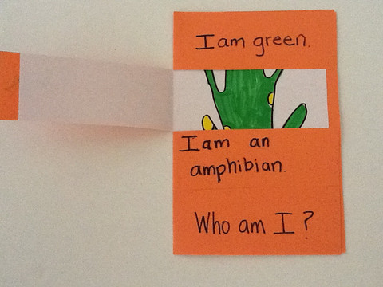
Riddle Me
Model making a riddle with a content vocabulary word. For example, pyramid: "I am heavy, made of blocks, and very old. What am I?"
Students can make their own riddle on cards with the clue on one side and the answer on the other. Or with a foldable with 4 flaps to open on the cover to reveal a picture of the vocabulary word .
Variations & Extensions - For younger or lower proficiency students, write down what they dictate or provide sentence frames like, “I am _____.” “I feel _____.” “I look _____.” Provide a word list to help students write their clues.

Slide 28
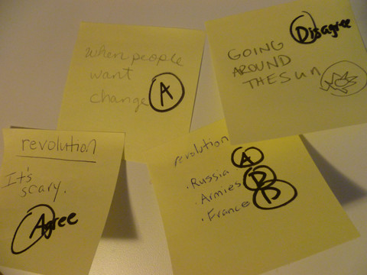
Stick It and Check It
Before study of a new topic students write what they know about the topic on a sticky note and stick it on a chart or a space on the wall or whiteboard.
After studying the topic whole class, small groups, or individuals return to the wall, take their note and either agree or disagree with the information listed there with an “A” for agree and a “D” for disagree.
Variations & Extensions – Direct students to take a sticky that is not their own and correct it. When students are done correcting, they can list the correct information on the whiteboard in complete sentences. Next, whole class, in small groups, pairs, or individually, students use the listed information to write a summary or an essay about what they learned about the topic. Lower proficiency students can write with a higher proficiency partner or copy sentences from the board that reflect what they learned.

Slide 29
Stick It and Check It With Technology
Stixy

Slide 30
Review Objectives
Content Objective:
The participants will learn and practice classroom strategies that are effective for the instruction of ELLs.
Language Objective:
The participants will discuss and orally evaluate classroom strategies for ELLs.

Slide 31
Tickets Out- 3,2, 1
Name 3 things you liked about the after school SIOP PDs this year.
Name 2 things you would want to change about the SIOP PDs you attended.
Name 1 suggestion you have for next year that would help you feel more supported in your efforts to implement SIOP in the classroom.

