Slide 1
Academic Vocabulary & Higher Order Questions For ELLs
Facilitators:
● Erica Hilliker
● Casey Gordon

Slide 2
Objectives
Content Objectives:
We will evaluate vocabulary taught in the classroom.
We will examine vocabulary strategies for ELLs.
We will investigate higher order assessment of ELLs.
Language Objectives:
We will discuss and write essential vocabulary to be taught in a lesson.
We will discuss vocabulary strategies for ELLs.
We will write higher order assessment questions for ELLs.

Slide 3
The Challenge
The average native English speaker enters kindergarten knowing at least 5,000 words. The average ELL may know 5,000 words in his or her native language, but very few words in English. While native speakers continue to learn new words, ELLs face the double challenge of building that foundation and then closing the gap.

Slide 4
Don’t Be Fooled!
You may be surprised at how quickly a new ELL student can communicate verbally with peers, but remember that there is a big difference between social English and academic English.

Slide 5
BICS
Basic Interpersonal Communication Skills
Involves using language for social, face-to-face and every day situations.
Highly contextualized and provides lots of clues for comprehension.
Takes 0-2 years to acquire

Slide 6
CALP
Cognitive Academic Language Proficiency
Involves language skills and functions of an academic or cognitive nature.
Language needed to accomplish academic tasks.
Takes about 7-10 years to acquire.

Slide 7
Building Background
What is your process for selecting what vocabulary to teach in your classroom?
What types of vocabulary words do you focus on?
Think-Write-Pair-Share

Slide 8
The Three Tiers of Vocabulary
Tier 1: Common Words such as simple nouns, verbs, high-frequency words, and sight words.
- Examples: eye, travel, butterfly, paint brush
Tier 2: Academic Words commonly found in school texts but not in general conversations. Needed to comprehend academic text and class discourse.
- Examples: support, demonstrate, category, estimate
Tier 3: Content Words found rarely in school texts except in particular texts.
- Examples: spectrometer, equilateral, bayonet, tempera

Slide 9
Let’s Practice
Read the passage “A Change in Climate”
Divide a piece of paper into 3 columns
Label the columns Tier 1, Tier 2, Tier 3
Record vocabulary words from the passage under each of the three columns
After everyone at your table is finished, discuss your choices with the rest of your group.

Slide 10
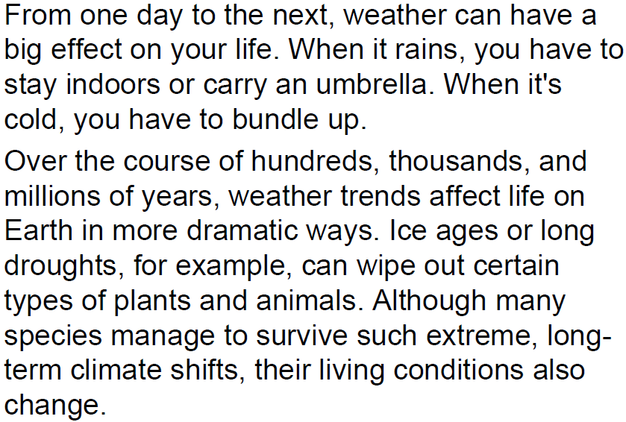
A Change in Climate

Slide 11
Key Vocabulary- Debrief
What are the words that you wrote first (Tier 1, 2, or 3)?
How does thinking about the 3 tiers of vocabulary help you?
How could you apply this in your classroom?

Slide 12
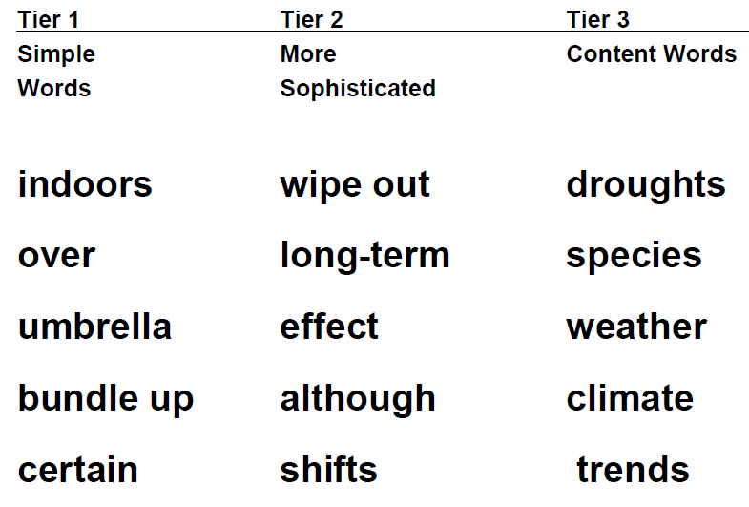
Vocabulary Tiers for ELLs

Slide 13
Key Vocabulary
Academic Language
Examples
Content Words
Process or Function Words
Words and word parts (i.e., affixes, roots) that teach English structure
Multiple Meaning Words
Connectives
Graph, axis, y-intercept
Locate, determine, identify
Graph (Related words: photograph, geography, pictograph)
Table, multiple, difference
And, but, because

Slide 14
Teaching Vocabulary
What methods do you use to teach new vocabulary words to your students?
Think-Write-Pair-Share

Slide 15
Researched Based Tips for Vocabulary Instruction
Direct instruction of words (provide student-friendly definition)
Presenting the word in context
Visual support (pictures, definition in glossary)
Translation of word
Using the words in the context of the lesson
Student interaction with words (activities and questions that make students use the words)
Student internalization of definitions (retelling the definitions in their own words)

Slide 16
Double-Entry Word Journal
Kindergarten version (teacher takes dictation)
Upper-grade version (students write their own entries)
Word | The ways we used it
Tiptoe | Ms. Smith said, “Please tiptoe to your seats.”
Parade | “We look like a parade when we walk with our heads and knees held high,” said Mr. Jones.
Word | How I used it
Intently | I asked my dad why he was looking at the paper so intently.
Flung | I told my mom I had flung my towel over the porch rail.

Slide 17
KIM Strategy
1. Provide students with index cards or use regular writing paper.
2. Inform students that they will use and advance organizer called KIM.
3. Model KIM on the board by using one content vocabulary word.
4. The information or synonyms in the middle section should be limited to short phrases or words.
5. Have students draw a picture of the vocabulary word.

Slide 18
KIM
K Key Word | I Information | M Memory Clue
Carve | Slice Cut
Organization Idea: A simple way for students to keep this bank of knowledge is for them to keep their cards together by hole punching them on the top left corner of the card. Tie a piece of yarn to the cards to hold them together.

Slide 19
Concept Definition Maps

Slide 20
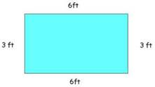
Four Corners Vocabulary
Vocabulary Word: perimeter | Illustration:
Definition: The distance around the shape | Sentence: Mrs. Grube asked the student to measure the perimeter of the rectangle.

Slide 21
Word Sorts

Slide 22
Wallpapering
The teacher begins with a key concept that will be studied during the lesson, and places that concept on the board.
The teacher then asks students to think about what they already know that relates to this concept and to write their ideas on a post-it note and place their post-it note on the board.
The “wallpaper” that results can be then sorted/classified, turned into a word wall.

Slide 23
Let’s Practice
Key concept = Bloom’s Taxonomy
Individually record what you already know about Bloom’s Taxonomy on post-its
One idea per post-it
Place the post-its in the middle of your table
As a group, sort your post-its into 4 categories and decide on a label for each column

Slide 24
List-Group-Label
1. Select a main concept in a reading selection.
2. List: Have students brainstorm all the words they think relate to the topic.
Visually display student responses.
At this point do not critique student responses. Some words may not reflect the main concept, but hopefully students will realize this as they begin grouping the words in the next step.
3. Group: Divide your class into small groups. Each group will work to cluster the class list of words into subcategories. As groups of words emerge, challenge your students to explain their reasoning for placing words together or discarding them.
4. Label: Invite students to suggest a title or label for the groups of words they have formed. These labels should relate to their reasoning for the grouping.

Slide 25
Word Generation
“port”
import
export
airport
transport

Slide 26
Phonic Adaptation
-ss
miss
kiss
fuss
pass

Slide 27
Word Quadrant
Pack

Slide 28
Phonics Quadrant
Ch Child Chair Cheese | Sh Ship Share Shout
Wh Where Whole White | Th The They Them

Slide 29
Vocabulary Mental Connections
Word Conflict | Synonym ●fight ● struggle | Antonym ● peace ● agreement
Procedures:
1. Use 3X5 index cards, plain white paper, or construction paper.
2. Introduce new vocabulary, one word at a time, from the content students have read.
3. Have students write the word on front of card as the teacher models the writing.
4. Have students make a personal mental connection for the new word.
5. Have students draw an illustration of that mental connection underneath the word.
6. Create a T-chart in back of the card and solicit 2 synonyms and 2 antonyms.

Slide 30
Word Study Books
This is a student-made personal notebook in which the student includes frequently used words and concepts. Book can be organized by language structure: -tion, -sion, -tation and/or alphabetical, and/or by topic of study (ex:Revolution words)
One way to enter words: Write the word, include a personal definition, use the word in a sentence, and add a memorable symbol or drawing that will trigger the word from memory.

Slide 31
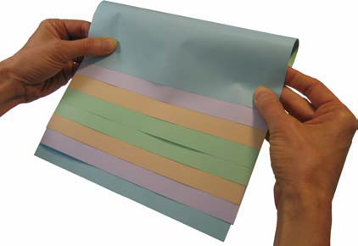
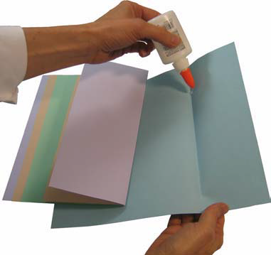
Vocabulary Cards and Flip Books
1. Stack four sheets of paper (8 ½” x 11”) together, placing each consecutive sheet around ¾ of an inch higher than the sheet in front of it.
2. Bring the bottom of both sheets upwards and align the edges so that all of the layers or tabs are the same distance apart.
3. When all of the tabs are equal distance apart, fold the papers and crease well.
4. Open the papers and glue them together along the valley/center fold.

Slide 32
Partners/ Mix and Match
Decrease
Ideas for Use:
Pass out cards with the words to half the class and the picture cards to the other half of the class. Have students stand and let them find their partners.
In cooperative groups, have students mix their cards and begin the matching process.
Have students mix the cards around, face down, and allow them to find the partner card through concentration.

Slide 33
Phonics Adaptation
 | Ch Chair

Slide 34
Signal Word Posters

Slide 35
Signal Word Posters

Slide 36
Building Background
How do you assess ELLs’ higher order thinking skills?
What do you do in your classroom?

Slide 37
How to develop questioning strategies for ELLs
Choose easy questions for your ELLs and structure the form of the question to their current language ability. Accept single word/phrases as correct answers. Do not insist that students speak in full sentences.
Let ELL students know which questions they will be responsible for answering in advance. Allow for think time and preparation of answers.

Slide 38
Hierarchy of Questions
1. Ask newcomers to point to a picture or word to demonstrate basic knowledge.
"Point to the penguin."
2. Using visual cues, ask simple yes/no questions.
"Is a penguin a fish?"
3. Ask either/or questions in which the answer is embedded.
"Is a penguin a mammal or a bird?”
4. Break complex questions into several steps.
"Look at the mammals. Find the bear, the dog and the cat. Why are these animals all mammals? How are they the same?"
5. Ask simple "how" and "where" questions that can be answered with a phrase or a short sentence.
"Where do penguins live?" How do bats hear?
6. Do not expect your ELLs to answer broad open-ended questions.
"How do fish breathe underwater?"

Slide 39
Higher Order Assessment
Level 1: Knowledge
This level of questioning is what is most frequently used when teaching ELLs, especially for students in pre-production and beginning production levels of English language acquisition. Responses to some of the questions can be made using yes/no or embedded questions. Pictures, drawings, and realia will help students give the correct answer. Responses to these questions are generally right in the text.
Examples:
Label a pictorial timeline with the sequence of events.
Define words using illustrations.
Collect magazine pictures that remind you of the story or text.
Show the right order of scrambled pictures from the story or text.
Match the vocabulary to the correct picture.
Arrange the sequence of events using the correct picture.

Slide 40
Higher Order Assessment
Level II: Comprehension
This level shows that the student has understood the facts and can interpret them. ESL/bilingual teachers use this level of questioning a lot. We ask students to compare, contrast, illustrate, and classify. We do this oral questions and graphic organizers such as Venn Diagrams and T-charts.
Examples:
Describe what happened before and after using illustrations.
Contrast two characters of concepts using a Venn Diagram.
Outline the main idea and details using bullets or illustrations.
Summarize the events of the story or chapter using pictures.
Retell the story or chapter in your own words, use body language.

Slide 41
Higher Order Assessment
Level III: Application
Students are learning to solve problems by using previously learned facts in a different way. ELLs might need scaffolding and word banks to build, choose, construct, develop, organize, plan, select, solve, and identify.
Examples:
Examine the pictures in the text and create new ones.
Create a travel brochure of the scenes in the story or text.
Construct a scrapbook or flipbook of the topics studied.
Demonstrate the knowledge learned and create an illustration.
Show how the character’s problems are related to people you know.
Transfer a character of concept into a different story or chapter.

Slide 42
Higher Order Assessment
Level 4: Analysis
At this level students may not have enough vocabulary and language to express responses in English. The tasks at this level that English language learners will be able to complete with some teacher scaffolding are: classify, contrast, compare, categorize, sequence.
Examples:
Analyze attributes of a character/concept; create an attributes map.
Arrange the characters or events in order by importance.
Classify persons, places or things from the story or text on a chart.
Separate the causes and effects using a T-char.
Infer other possible outcomes from the story or text.
Order the sequence of events from beginning to end.

Slide 43
Higher Order Assessment
Level 5: Synthesis
At this level students are compiling information together in a different way by combining elements in a new pattern or proposing alternative solutions. ELLs will need teacher support and scaffolding to answer questions at level 5. Synthesis is particularly difficult for ELLs. Students may be able to choose, combine, create, design, develop, imagine, make up, predict, solve, and change.
Examples:
Design a poster to make people want to read the story or text.
Invent a product that can be used in the story or text.
Modify the front cover of the book and give it a different title.
Plan a play to illustrate the story or content.

Slide 44
Higher Order Assessment
Level VI: Evaluation
Questions at this level of Bloom’s taxonomy can be modified so that the langue is simplified but the task remains the same. English language learners can learn to give opinions, make judgments about the action in a story and evaluate the work of an author. The vocabulary usually associated with evaluation may need to be simplified.
Examples:
Grade other authors and their books, describe criteria for grade.
Rank favorite events read and tell why you rank them in that order.
Judge whether or not characters should have acted as they did.
Recommend why the book should be read by others and why not.
Measure the effectiveness of the author’s purpose using criteria.

Slide 45
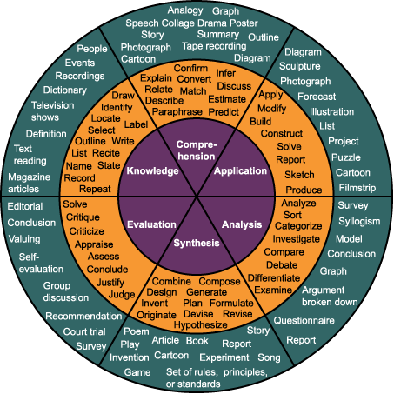

Slide 46
Let’s Practice!
Divide into groups by grade level and/or content area.
Select a topic or content concept you will teach.
Write a question for each level of Bloom’s Taxonomy related to this content concept that could be used with students of lower English proficiency.
Report to the group.

Slide 47
Higher Order Sentence Stems for ELLs
Students can answer questions on increasingly sophisticated levels of cognition using the following prompts:
Knowledge: The definition of (topic) is __________________.
Comprehension: (Topic) can be explained as ______________.
Application: An example of (topic) is ___________________.
Analysis: (Topic) can be compared to ____________________.
Synthesis: If I create a diagram of (topic) I would include _______ ____in my diagram.
Evaluation: We can conclude that (topic) _______________.

Slide 48
Scaffolding Techniques for ELLs
Simplifying the language: The teacher can simplify the language by shortening selections, speaking in the present tense, and avoiding the use of idioms.
Asking for completion, not generation: The teacher can have students choose answers from a list or complete a partially finished outline or paragraph.
Using visuals: The teacher can present information and ask for students to respond through the use of graphic organizers, tables, charts, outlines, and graphs
Provide anchor charts with vocabulary that students can refer to when answering a question.
Always show students the outcome or product before they do it. If a teacher assigns a persuasive essay or inquiry-based science project, a model should be presented side-by-side with a criteria chart or rubric. You can guide students through each step of the process, model in-hand of the finished product.

Slide 49
Objectives
Content Objectives:
We will evaluate vocabulary taught in the classroom.
We will examine vocabulary strategies for ELLs.
We will investigate higher order assessment of ELLs.
Language Objectives:
We will discuss and write essential vocabulary to be taught in a lesson.
We will discuss vocabulary strategies for ELLs.
We will write higher order assessment questions for ELLs.

Slide 50
Tickets Out
I think…
I wonder…
I feel…
I want to learn more about…

